Slide 1
For Google Maps for Work
cmapsanalytics.com sales@cmapsanalytics.com +1.800.570.6806

Slide 2
About Centigon Solutions
Incorporated 2008: San Diego CA
Our Mission: Help business enterprise professionals
to think spatially through Location Intelligence.
When Location, Proximity and Distance are Important to Answer Questions.

Slide 3
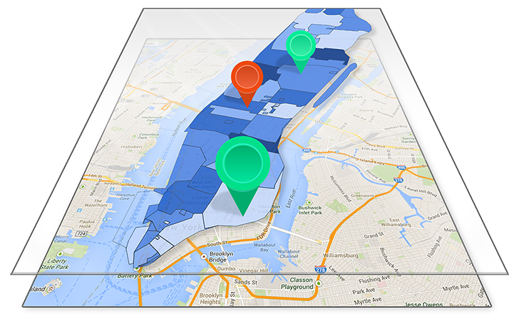
Our Secrets to Location Intelligence Success
WHY IT STAKEHOLDERS CHOOSE IT
No IT footprint, low maintenance
GIS is a feature, not a requirement
Lots of features & resources
Native extensions into BI (SAP)
WHY BUSINESS USERS LOVE IT
Consumer friendly
Simplicity (no training)
Access everywhere

Slide 4
What happens when you use Location, Proximity, and Distance Effectively?
1. Maps from Nice to Have to Must Have
2. Make Better Decisions
3. Drive Higher User Adoption

Slide 5
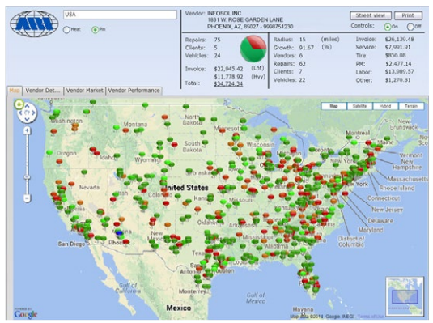
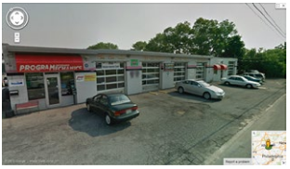
Customer Use Case
Drill down to sales territory, select vendors based on pre-determined KPI thresholds, use street geo data to negotiate new terms with vehicle repair and maintenance on behalf of customers.
ARI – “ARI’s Vendor Management Dashboard increased our team’s capacity to prioritize vendors by geography, lower preferred
customer rates 50%, increase sales for our vendors by 20%, and reduce customer’s overall maintenance costs by 20%”

Slide 6
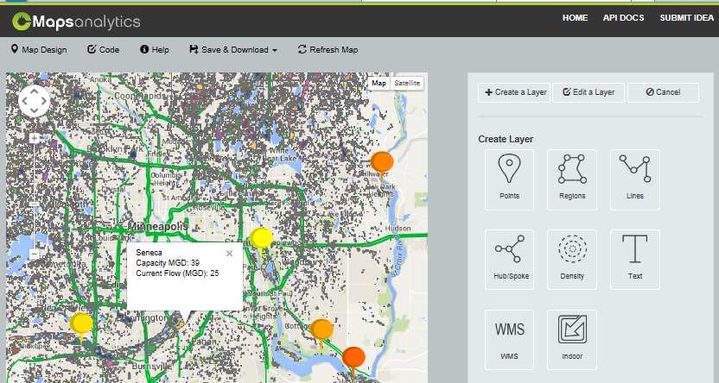
CMaps Analytics Integration with Google Maps
CMaps Extensions
CMaps Analytics Views Design Once, Deploy Everywhere!
SAP BusinessObjects
Microsoft SharePoint
3rd Party Analytics ISVs
More on the Way!
CMaps JavaScript API
CMaps Analytics API
HTML5 Apps / Mobile
SAP UI5
CLICK ICON TO VIEW DETAILS

Slide 7
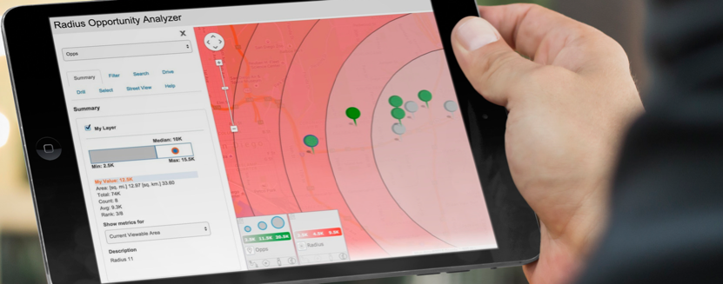
INTRODUCING CMAPS ANALYTICS API V2
Graduate enterprises from “thinking maps” to Location Intelligence
Provide amazing embedded location intelligence experiences
Work with platforms and partners to expand CMaps everywhere
http://centigontesting.com/centigonTestView/v2/RadiusDistanceOpportunityAnalyzer/CMapViewRadiusDistOppAnalyzer.html

Slide 8
CMaps Analytics Designer
CMAPS DESIGNER
Design once, embed anywhere
Google Maps foundation
Over 15 Data Viz Types
Optimized for Analytics Apps
Improved lifecycle management

Slide 9
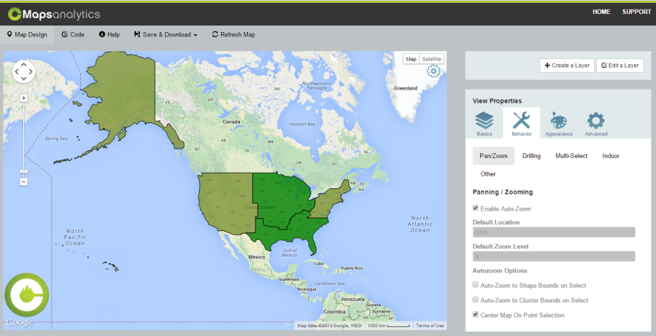
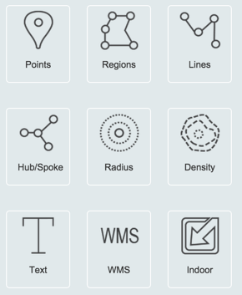
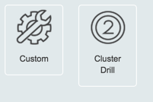
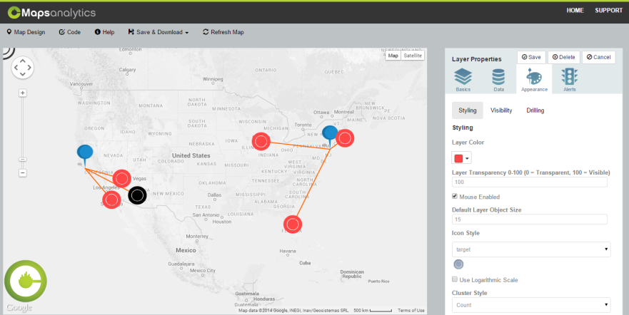
CMaps Designer
Accelerate Design without coding
Familiar property sheet maps design
Built in tools to filter, drill, aggregate, sort
Increase BI User Adoption!

Slide 10
How it Works: Custom Apps
Your App
<script src=”https://api.cmapsanalytics.com?v1.2”>
var cMap;
function buildMap(){ //creates the map instance cMap = new centigon.locationIntelligence.MapView();
cMap.onMapReady = function(){console.log('map is ready');}
//applies the config xml
cMap.parseConfigXml(mapCfg);
CMaps Analytics APIs
CMaps Template
var=mapCFG
Your Data
Your App Code
Rapid prototype and design maps
Define layer types and relationships
Add behaviors, default data viz, properties
Export template project
CMaps Extensions
Your HTML5 Apps
Partner Extensions
CMaps Analytics Views / Templates
CMaps Analytics Designer
Connect and customize with JS API
Integrate directly with your app
CMaps Analytics APIs

Slide 11
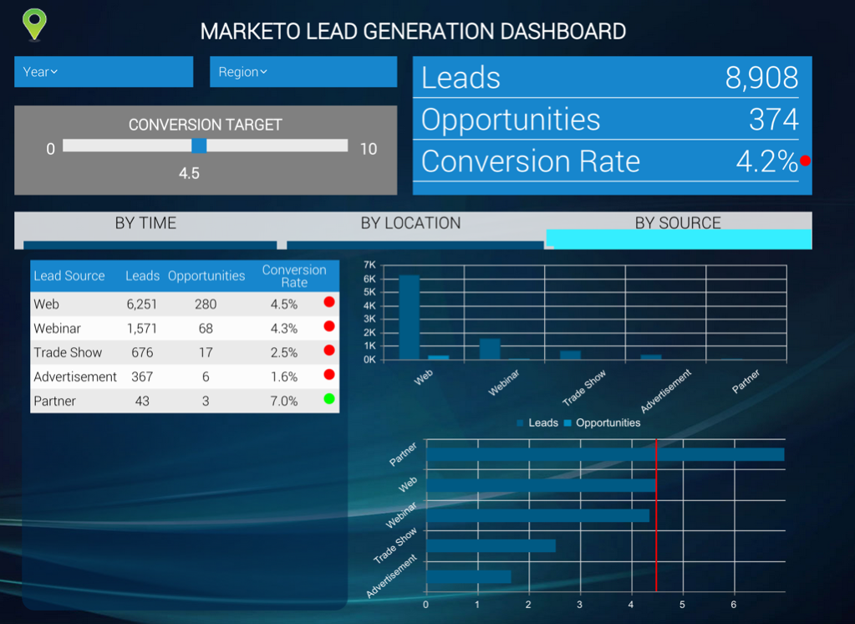
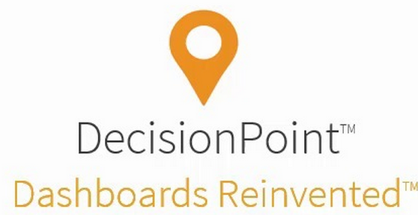
Embed CMaps in your Commercial Apps
http://antivia.com
Agile codeless design
Inbuilt Interactivity
Rapid deployment of dashboards against any data source
Omi-channel delivery of BI – Desktop and mobile
Delivering value of Business Intelligence to the masses…not a select few
Notes:
http://centigonknowledge.com/cmapsanalytics2015-web-event/
Here is agenda:
Why Location Matters - highlight customer stories
- Highlight travel recon - have Ryan on as a guest to tell his story
- Why proximity and distance matters- Tell the FMCI story
Highlight the location intelligence market spectrum- Every BI vendor needs a maps solution out of the box. Some vendors will invest more than others.
Graduate From Maps to Location Analytics with CMaps Analytivs V2 API
- custom apps example
- Go into Designer and see what it takes to create and manage the map.
From custom apps to rapid dashboard design - DecisionPoint
- Have Donald on as guest to do DecisionPoint (highlight why they chose CMaps)
From Plugin to Platform - Re-iterate we are a cloud platform- what is CMaps Analytics - iterate importance of partners.
SAP- 2 min custom Lumira extension demo- Show how we take an XML open in WebIDE and spit out an extension in 2 minutes- Install into Lumira and wire up some address data from China. Batch geocoding, no geographic limitations. Then do a street view or something cool like that if possible.
Salesforce.com Canvas component - This is a stretch goal- Trying to get Andi team to wire up CMaps inside of Salesforce1- Announce that we will have a native extension for Dreamforce (hopefully). I am going to offer bringing Andi on to promote his company and present if he can get it done.
Mapify your KPIs- Going to announce a new program- This is catered to the business side.. Business Intelligence is not technology. People, process- So we are here to provide structure to create Location Analytics. Even if you don't use our technology, you can use our expertise to succeed..Something like that.
Ambitious but my thought is that from this, we can cut it up into 5 or 6 videos and put all over the web to target different markets.
My goal is to have outbound email to all 100 BI companies by the end of next week all who will be invited to this event. No pressure at all but I want to make one big ass push as if this is our annual conference.

Slide 12
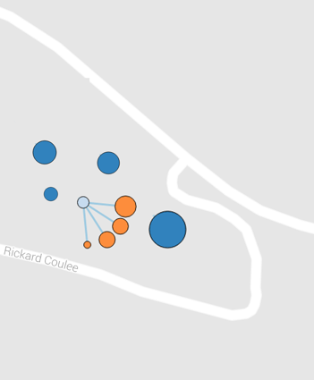
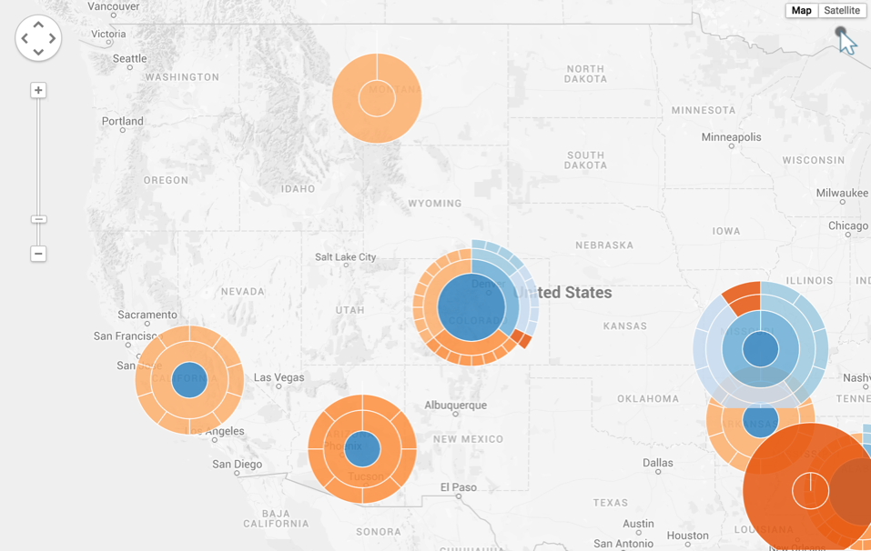
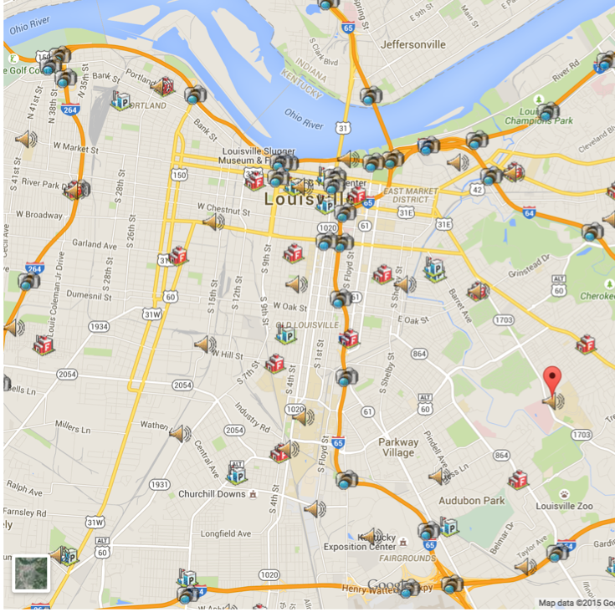
NEW CUSTOM LAYERS Initially Available for CMaps Analytics API, soon available in SAP extensions.

Slide 13
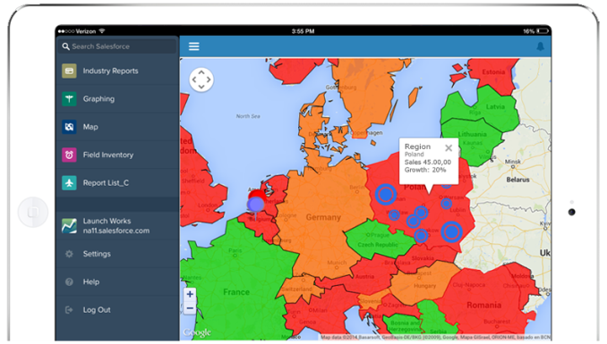
What’s Next: 2015 Roadmap
Expanded Integration
SAP Lumira Toolkit
Support for ESRI Layers
SAP Design Studio
New Wave of Partner and OEM Integrations
Partner solutions with out of the box support for CMaps Analytics Designer views.
LaunchWorks embedded analytics for Salesforce.com
More Customer Success
ARI – “ARI’s Vendor Management Dashboard increased our team’s capacity to prioritize vendors by geography, lower preferred customer rates 50%, increase sales for our vendors by 20%, and reduce customer’s overall maintenance costs by 20%”
New Frontier: Indoor
Release of Indoor Map Designer
CMaps Cloud Services
Expanded Drive-time analytics
Expanded polygon geocoding
New D3 visualization types
Over 30 new maps templates
Notes:
http://centigonknowledge.com/cmapsanalytics2015-web-event/
Here is agenda:
Why Location Matters - highlight customer stories
- Highlight travel recon - have Ryan on as a guest to tell his story
- Why proximity and distance matters- Tell the FMCI story
Highlight the location intelligence market spectrum- Every BI vendor needs a maps solution out of the box. Some vendors will invest more than others.
Graduate From Maps to Location Analytics with CMaps Analytivs V2 API
- custom apps example
- Go into Designer and see what it takes to create and manage the map.
From custom apps to rapid dashboard design - DecisionPoint
- Have Donald on as guest to do DecisionPoint (highlight why they chose CMaps)
From Plugin to Platform - Re-iterate we are a cloud platform- what is CMaps Analytics - iterate importance of partners.
SAP- 2 min custom Lumira extension demo- Show how we take an XML open in WebIDE and spit out an extension in 2 minutes- Install into Lumira and wire up some address data from China. Batch geocoding, no geographic limitations. Then do a street view or something cool like that if possible.
Salesforce.com Canvas component - This is a stretch goal- Trying to get Andi team to wire up CMaps inside of Salesforce1- Announce that we will have a native extension for Dreamforce (hopefully). I am going to offer bringing Andi on to promote his company and present if he can get it done.
Mapify your KPIs- Going to announce a new program- This is catered to the business side.. Business Intelligence is not technology. People, process- So we are here to provide structure to create Location Analytics. Even if you don't use our technology, you can use our expertise to succeed..Something like that.
Ambitious but my thought is that from this, we can cut it up into 5 or 6 videos and put all over the web to target different markets.
My goal is to have outbound email to all 100 BI companies by the end of next week all who will be invited to this event. No pressure at all but I want to make one big ass push as if this is our annual conference.

Slide 14
How to Reach the Centigon Team
1800.570.6806
sales@centigonsolutions.com
http://cmapsanalytics.com
Our Social Network:
@cmapsanalytics.com http://facebook.com/centigonsolutions

Slide 15
Additional Slides As Needed

Slide 16
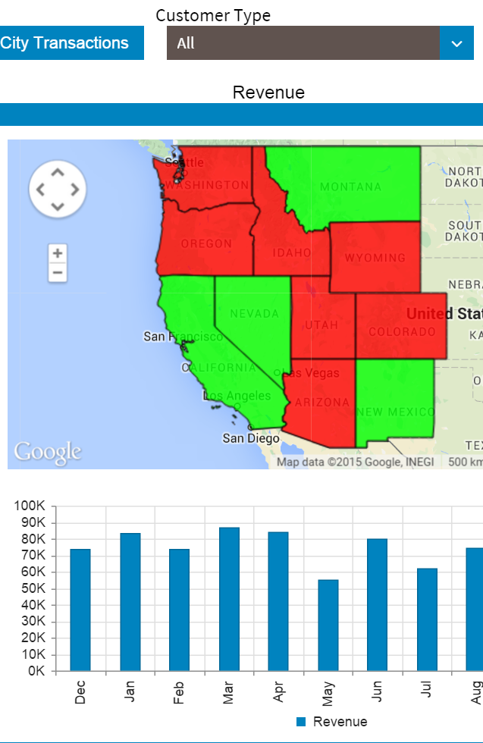
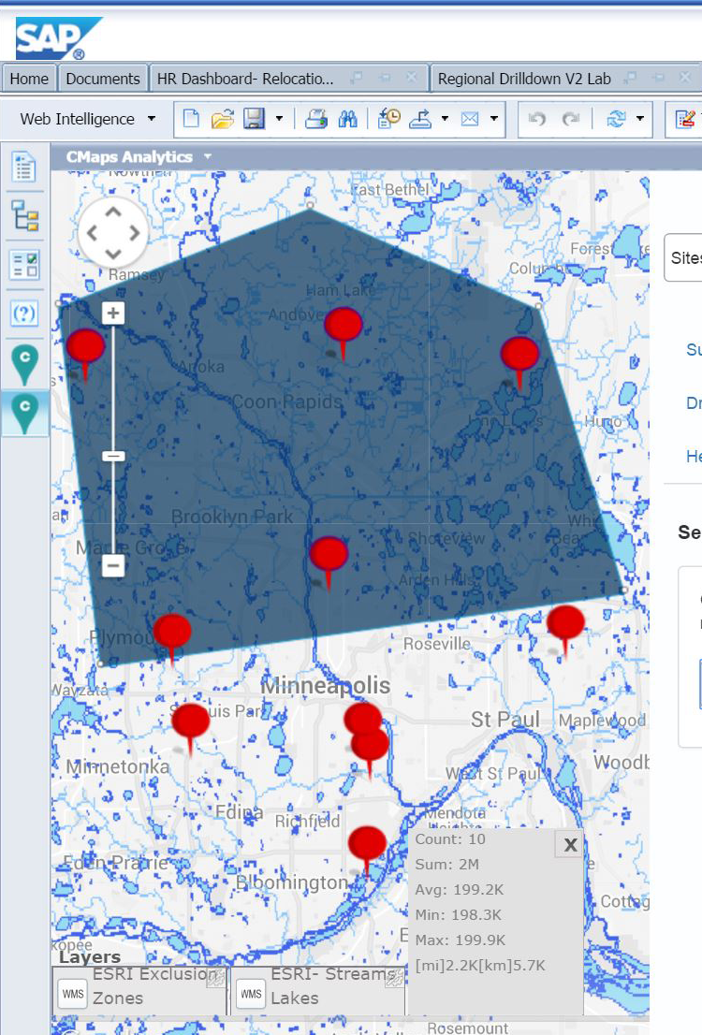
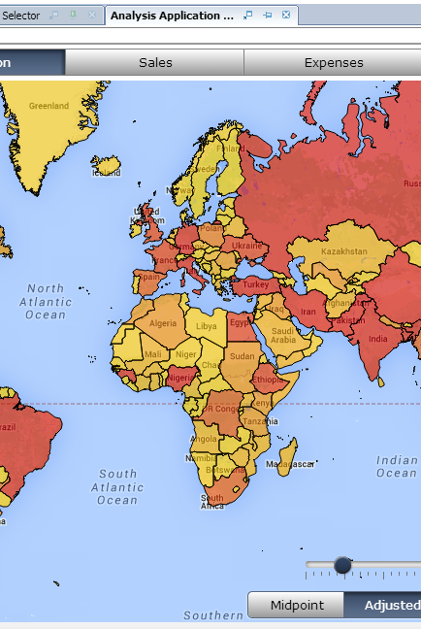
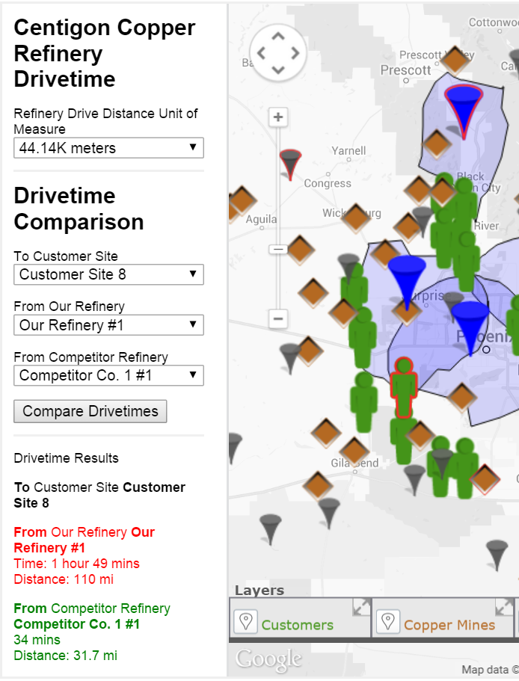
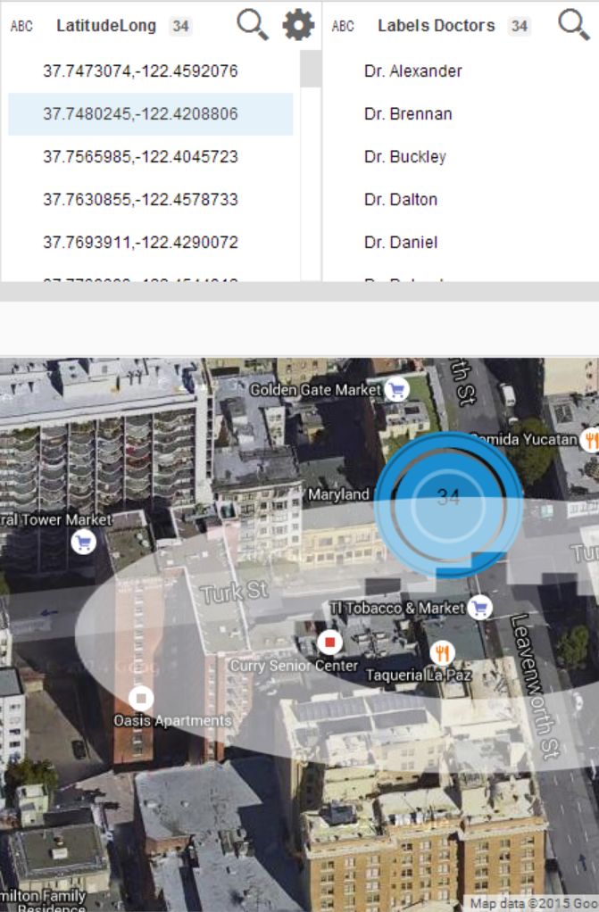
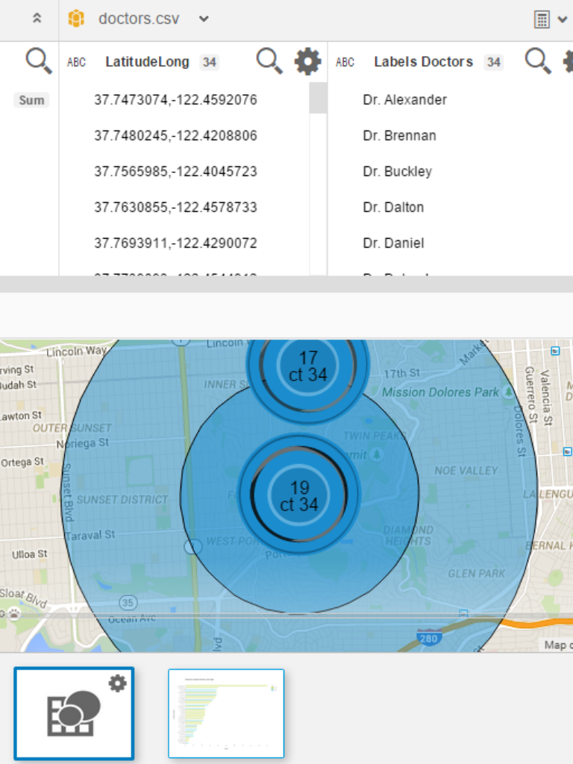
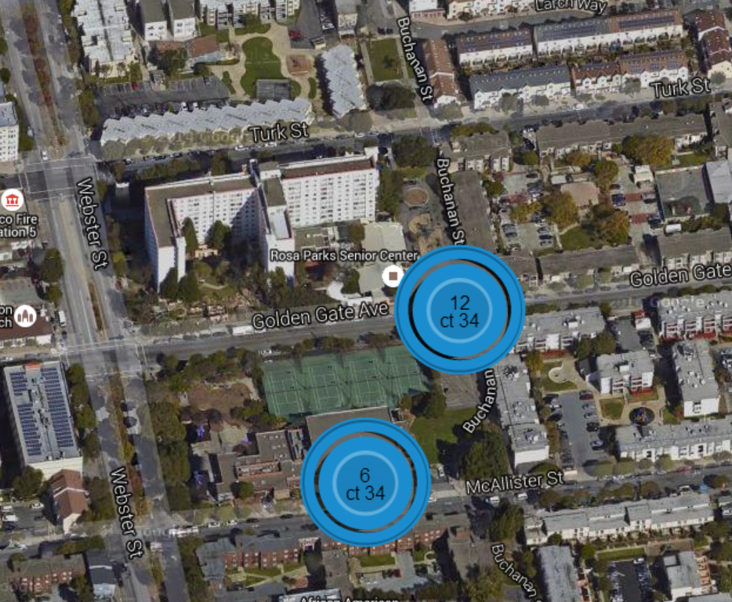
CLICK ICON TO VIEW DETAILS
CMaps Analytics Extensions for SAP BusinessObjects
Consistent design and development with consumer maps (Google Maps)
No servers, No IT footprint, No GIS skills required
Includes everything you need to create Location Intelligence
DASHBOARDS
MOBILE
REPORTS
EXPLORATION
APPS

Slide 17
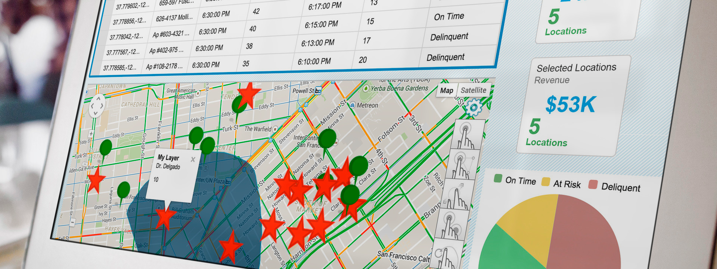
Embedded Location Intelligence
Integrate CMaps Analytics views with SAP UI5 for geospatial apps. Combine with HANA or embed in SAP Fiori Apps

Slide 18
Extensions Overview - Right features for the right role
IT / Developer
BI Professional
Power User / Analyst
Business User
CMaps Designer
VIEW & ANALYZE
CREATE / DESIGN
INSTALL
DEVELOP
SAP Dashboard Plugin
Webi Extension
Lumira Toolkit
CMaps JS API / SAP UI5
**Design Studio
Antivia Decision Point

Slide 19
NEW CUSTOM LAYERS Initially Available for CMaps Analytics API, soon available in SAP extensions.

Slide 20
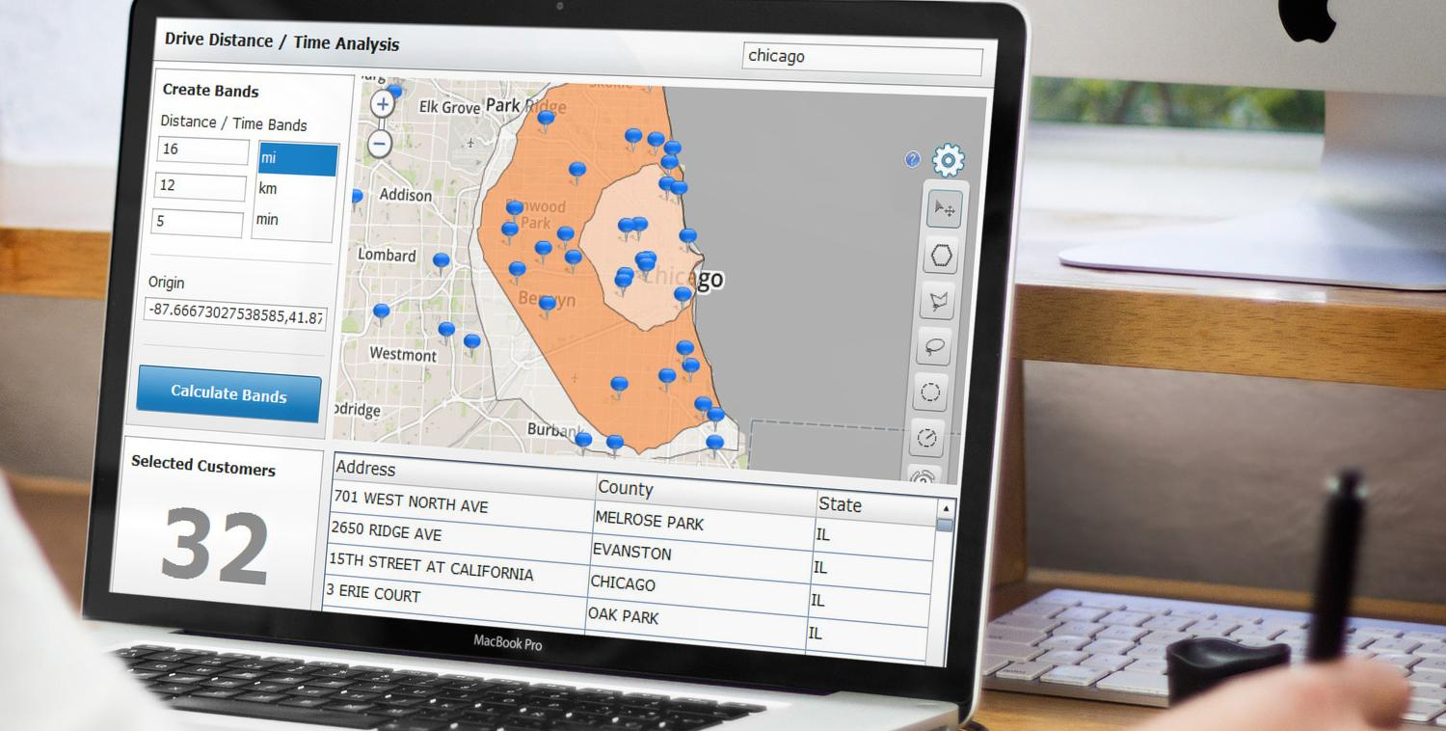
Drive time / Distance Polygons
NEW DRIVE TIME ANALYTICS
Drive time / distance polygons
Drive distance matrix for points powered by Google Maps for Work
Single and multi- way point routing and optimization.

