Slide 1
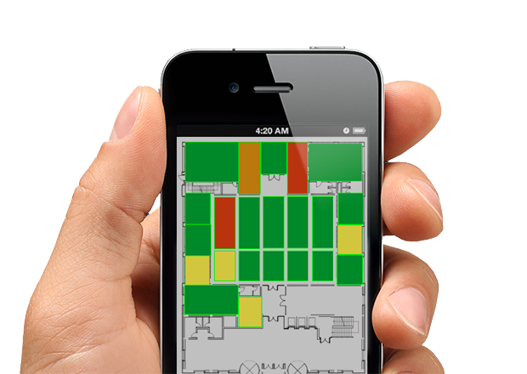
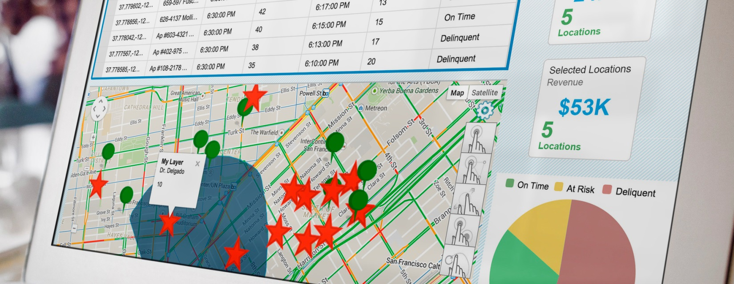
Location Intelligence
Simple, Consistent, Beautiful Experiences with CMaps Analytics

