Slide 1
CMaps Plugin
CMaps Analytics
for SAP BusinessObjects

Slide 2
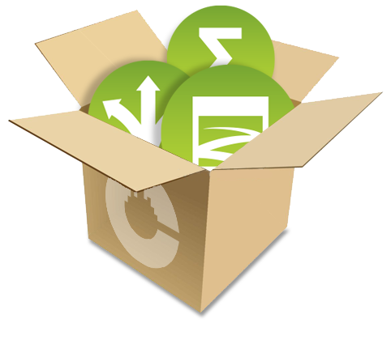
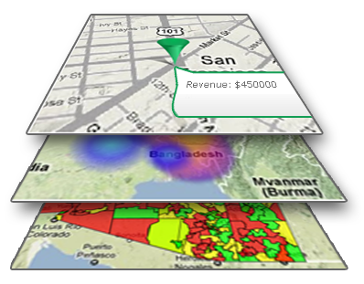
About Centigon Solutions
2008 First to release SAP certified add-ons for SAP BusinessObjects (over 650 customers worldwide)
2009 First to bring certified Google Maps integration to SAP BusinessObjects
2013 Launched CMaps Analytics- A suite of plugins, services and applications for creating and integrating location analytics.

Slide 3
CMaps Plugin (previously GMaps Plugin)
Most widely used mapping integration for SAP Dashboards.

Slide 4
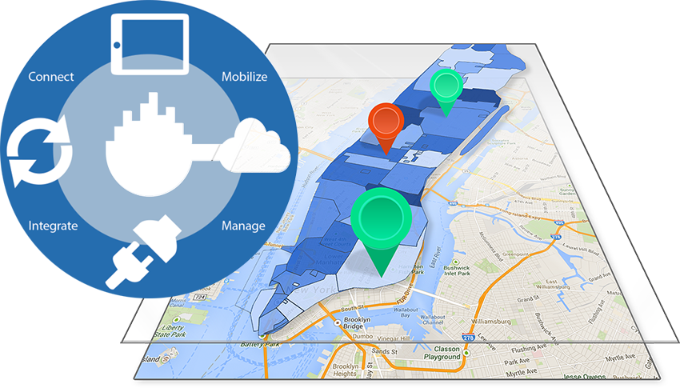
Next Generation of Location Intelligence for BI
WHY IT STAKEHOLDERS CHOOSE IT
Plug and play location analytics.
No GIS server requirements
No coding required
Mobile ready
Directly integrated into Business Intelligence tech and workflows
WHY BUSINESS USERS LOVE IT
Consumer maps experience.
Fluid, simplicity in use
Multiple tools for interacting with location data
Ability to view custom regions and assets together.

Slide 5
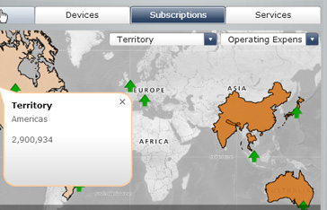
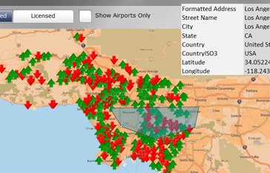
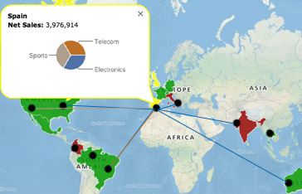
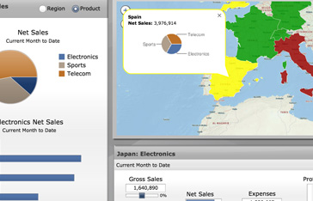
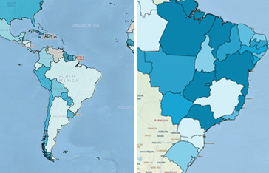
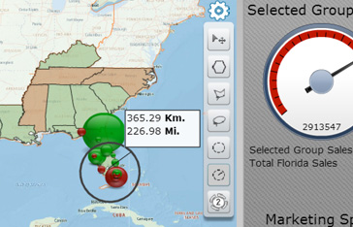
One Map Component- Unlimited Possibilities
Demos: http://cmapsanalytics.com/sapdashboards_features.html#demos

Slide 6
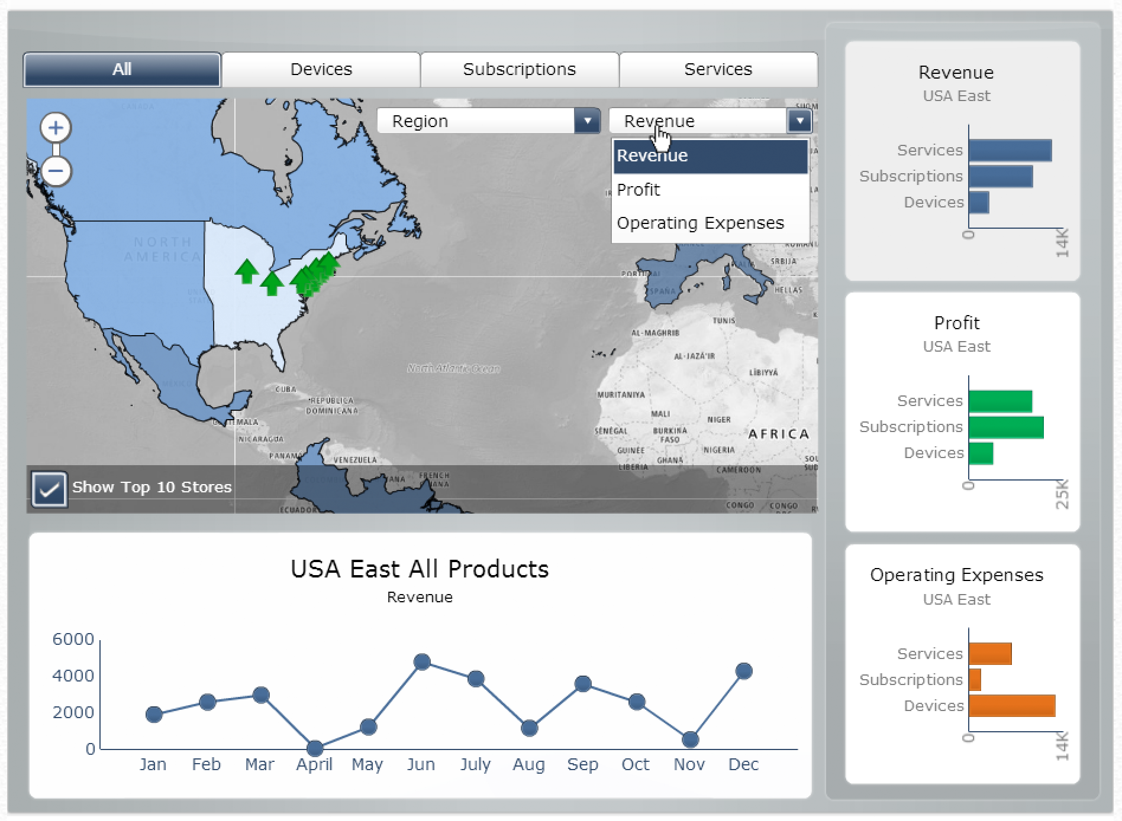
Executive Geo Dashboards

Slide 7
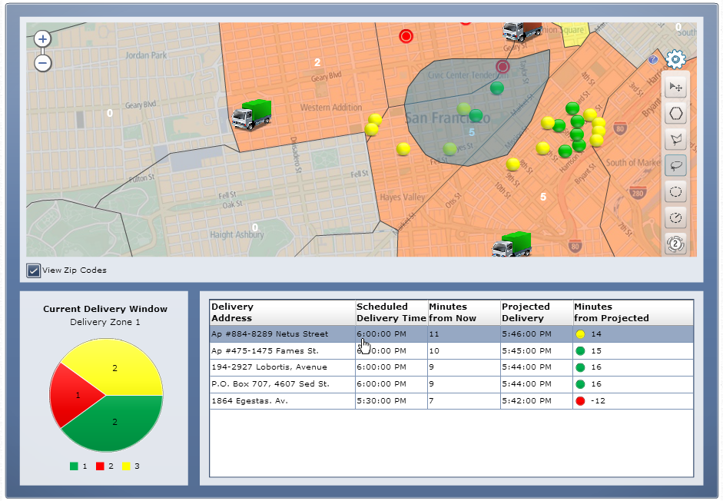
To front-line Operational Analytics
Demos: http://cmapsanalytics.com/sapdashboards_features.html#demos

Slide 8
Marketing Dashboard
Demos: http://cmapsanalytics.com/sapdashboards_features.html#demos

Slide 9
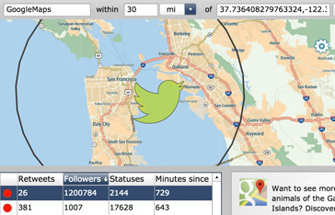
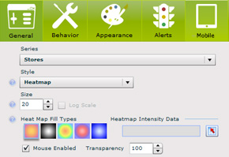
Location Analytics for SAP Dashboards
Plugin and play location intelligence with enterprise-wide scalability.
Display any geographic area or custom regions with business data.
Consumer friendly experience analytics tools for interactivity.
Point and click map design directly inside of SAP BusinessObjects Dashboards.

Slide 10
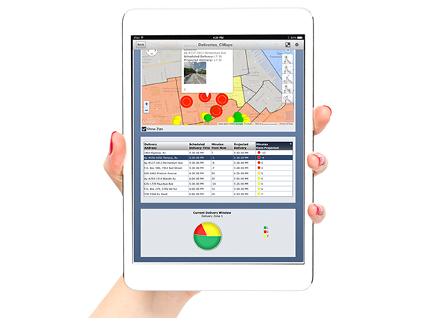
Mobile Integration SAP BI Mobile
CMaps Plugin 4.1 is mobile enabled via HTML5 integration with SAP Dashboards.
Mobile Integration uses Google Maps services.
No server-install requirements
Requires HTML5 enabled add-on component
Publish your geo-analytics dashboards to SAP Mobile BI
+

Slide 11
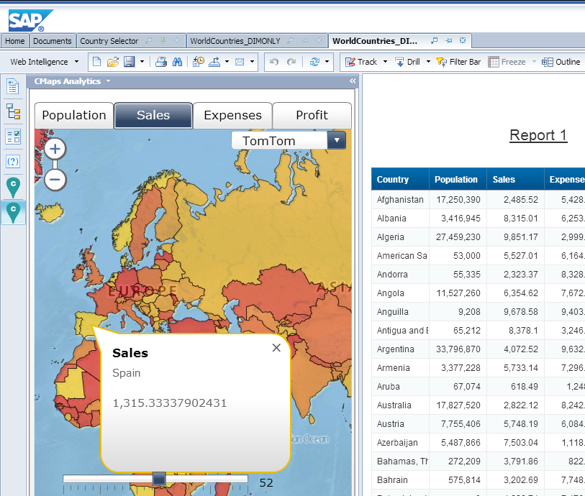
CMaps Plugin and Webi
Included as new CMaps Analytics Extension for SAP BusinessObjects 4.1 SP02 and Higher

Slide 12
How Webi Extension Works

Slide 13
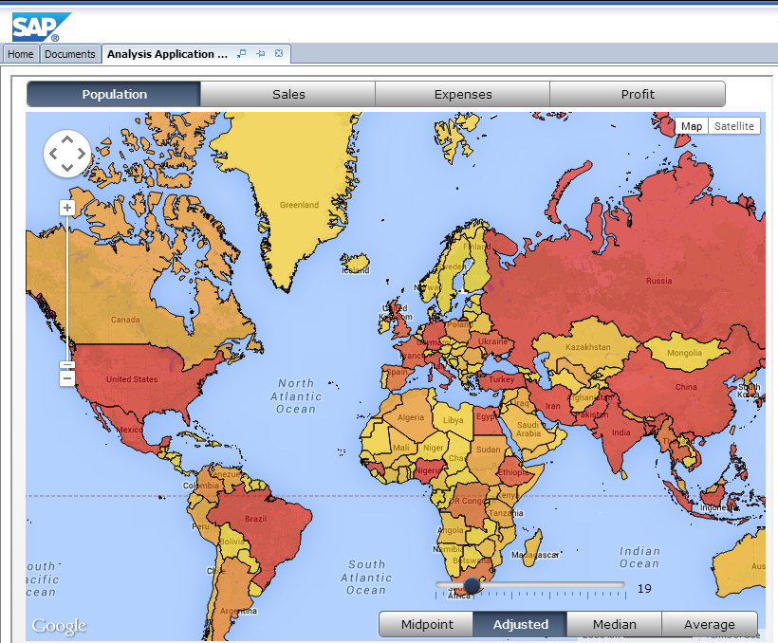
Design Studio
Integration via APOS Dashboard Migrator for Design Studio
Re-use CMaps Plugin dashboard content inside of Design Studio.

Slide 14
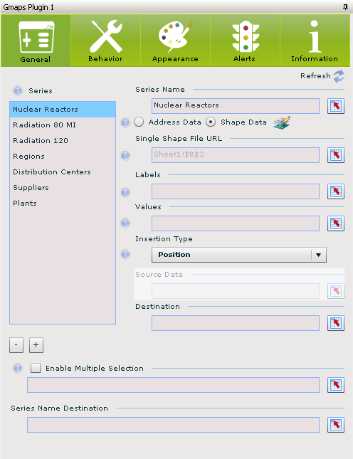
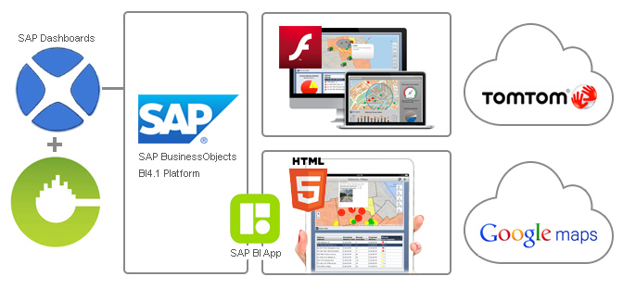
How it Works
1. Install directly inside of SAP Dashboards
2. Drag and drop CMaps Plugin into your dashboard
3. Configure your business data with regions or points
4. Publish Dashboard to SAP BusinessObjects
5. Access ANYWHERE: Dashboards, Mobile App, Webi, Design Studio

Slide 15
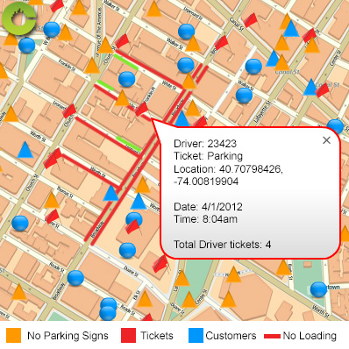
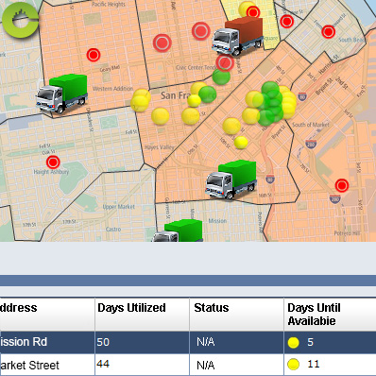
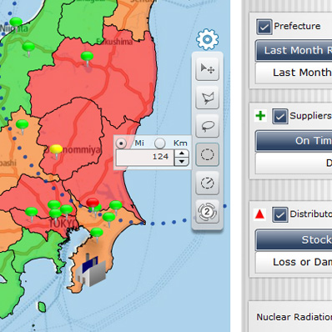
Top 3 Geo Use Cases
Combine business data and geography from different sources to create new insights
On-demand access to location and availability of assets, everywhere you go
Diagnostics to identify problems related to geography that accelerates decision making

Slide 16
CMaps Plugin IT Footprint
Simple Installation
NO database, NO server install
Minimal support and maintenance
NO IT intervention
Rapid Development
NO coding. Point & click, free form design;
Flexibility in deployment
PPT, PDF, Web BusinessObjects, SAP Netweaver Portal, LaunchWorks
Lowest Possible Total Cost of Ownership

Slide 17
Security
Maps Security
NO data displayed in the plugin leaves the user’s computer or is exposed outside your firewall.
Google & TomTom does do not get access to your data.
On Premise Security
CMaps Plugin inherits all SAP Dashboards data and access security through SAP Dashboards

Slide 18
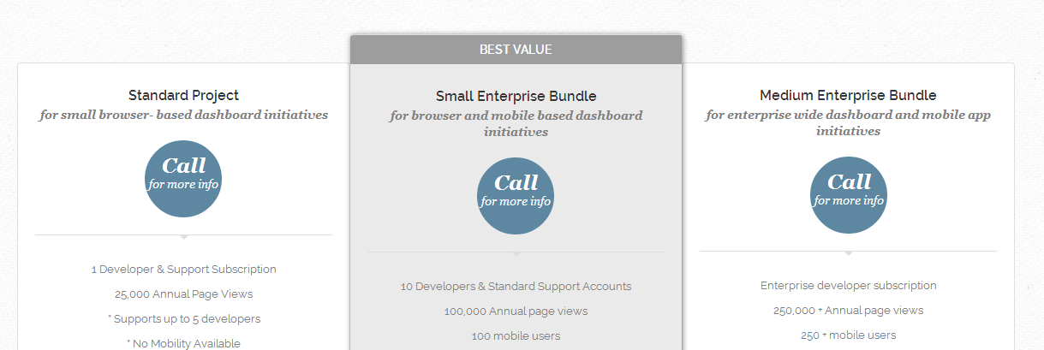
Enterprise licensing and subscriptions
Everything you need to build and deploy location analytics in 1 bundle.
*Subscription licensing and mobile availability in limited regions
http://cmapsanalytics.com/licensing.html

Slide 19
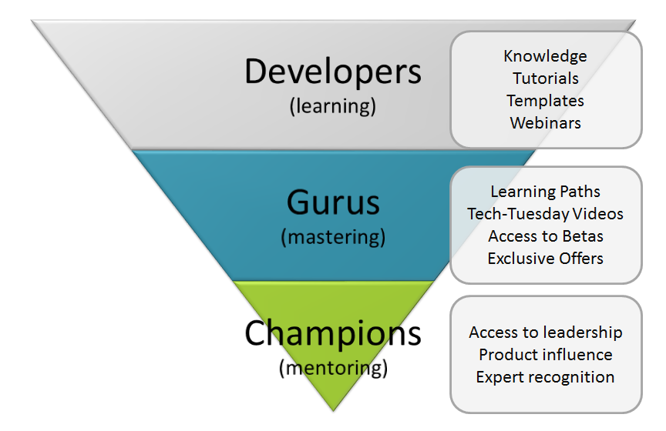
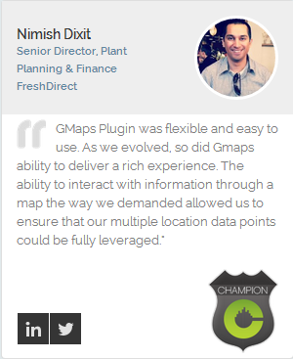
Knowledge and Education Paths
http://centigonknowledge.com
Searchable Knowledge
Technical training
Over 12 hours videos
Over 20 templates
Live Tech-Tuesdays
Global geo-data
http://centigonsolutions.com/gurus.html
http://centigonsolutions.com/champions.html

Slide 20
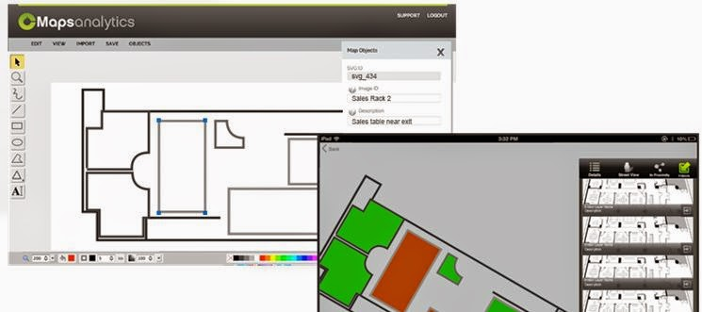
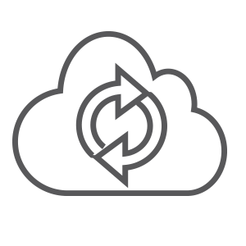
Innovation Pipeline
Indoor Analytics
New Integrations
Cloud Design and Services
Embedded
Geo Analytics

Slide 21
Where to Learn More
1800.570.6806
sales@centigonsolutions.com
http://cmapsanalytics.com
Our Social Network:
@cmapsanalytics.com
http://facebook.com/centigonsolutions
http://centigonknowledge.com/gurus

