Slide 1
CMaps Plugin
CMaps Analytics Designer
Sales Deck

Slide 2
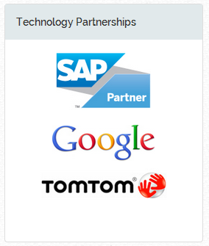
Centigon Solutions
Established: 2007
Independent Software Vendor
Leading provider of Location Intelligence for SAP BusinessOjects OUR GOAL:
Help business professionals to use business
data and geography to drive better decisions.

Slide 3
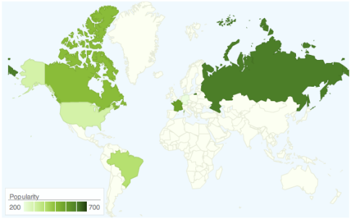
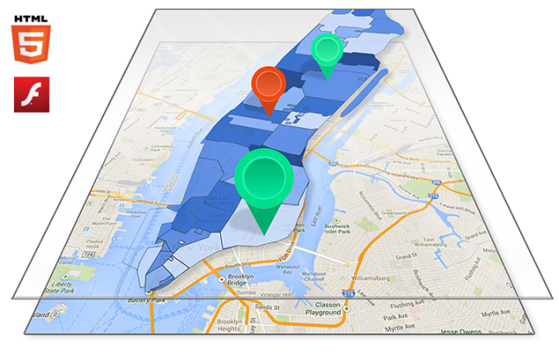
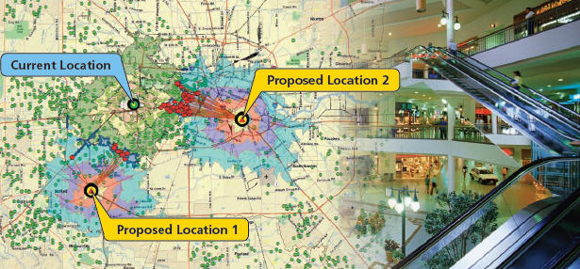
CMaps Analytics : “Location Intelligence w/o GIS”
Basic Maps
Static Map Visualization
Limited use cases for common geographies (choropleths)
Location Intelligence
Geographic scorecards, Regional
and asset performance, Mobile Executives, Sales, Management, Operations
Advanced Analytics
Store planning, trade area/routing analysis.
Analysts, GIS
Low Impact Many Users
Source: Geo Chart
Med-High Impact Many Users
Source: CMaps Analytics.com
CMaps Analytics
High Impact Few Users
Source: ESRI.COM
GIS

Slide 4
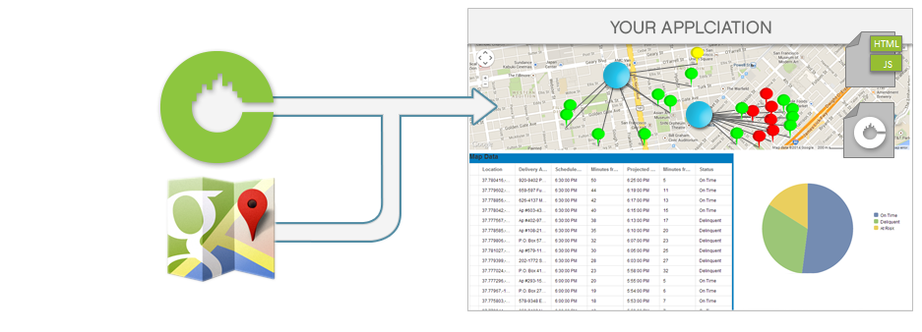
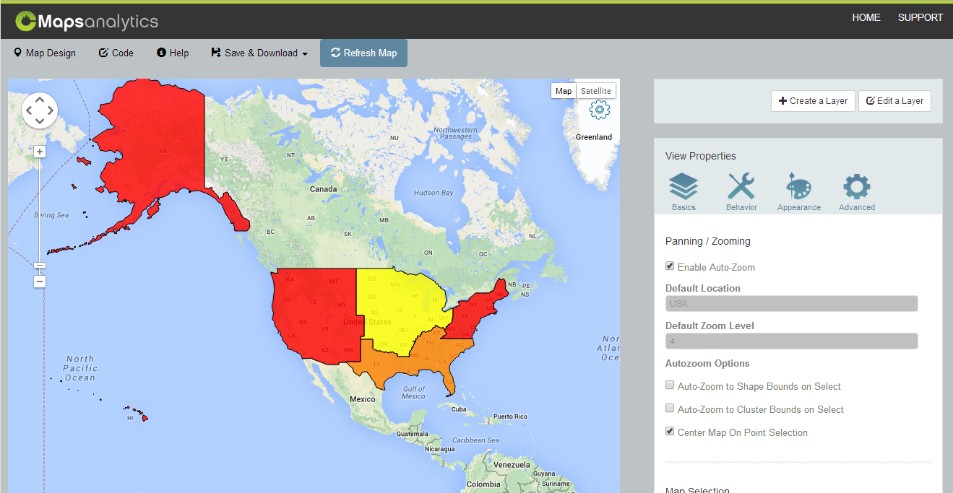
CMaps Analytics Designer
What is CMaps Analytics Designer?
Transforms consumer maps into embedded Location Intelligence experiences.
Design in the cloud, integrate EVERYWHERE!

Slide 5
Why CMaps Analytics Designer?

Slide 6
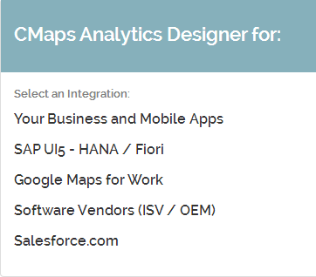
One Designer, Unlimited Possibilities

Slide 7
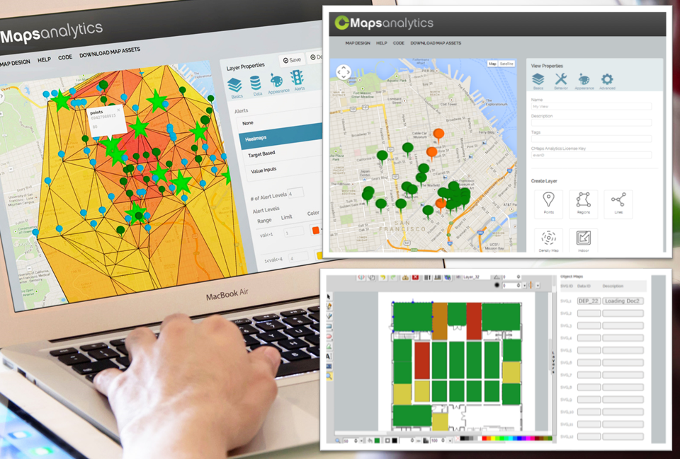
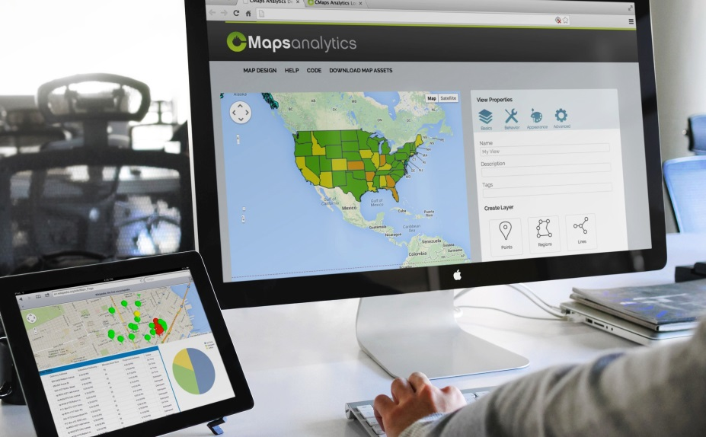
What’s Next for CMaps?
Point and click map designer (cloud based)
Solution: Embedded geo-analytics
Benefits: Time savings, boost user adoption
Features: Simplicity and flexibility to integrate powerful Google Maps experiences anywhere.
Target: Enterprise business apps, enterprise independent software vendors
Native and Partner Built Extensions for:
- SAP
- Salesforce.com (via LaunchWorks)
Centigon is a member of In-Location Alliance

Slide 8
Where to Learn More
1800.570.6806
sales@centigonsolutions.com
http://cmapsanalytics.com/designer
Sign up for a FREE test drive!
Our Social Network:
@cmapsanalytics.com
http://facebook.com/centigonsolutions

